Slide 1
Transducers-Moore and Mealy Machines

Slide 2
Moore Machine
Moore machines are finite state machines with output value and its output depends only on present state.

Slide 3




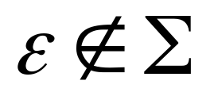
Formal Definition
Moore Machine M
M=(Q, ,O, ,f, )
: set of states
: input alphabet
O : output alphabet
: transition function from Q* -> Q
f : Q -> O
: initial state

Slide 4
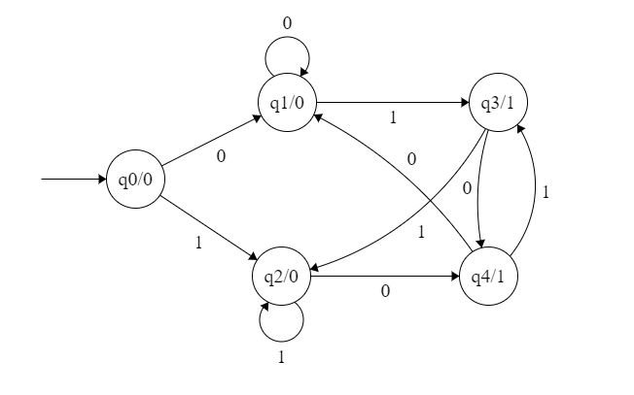
Moore Machine M
Input: 11 Transitions: (q0,11)= (q2,1)=q2 output: 000

Slide 5
Mealy Machine
Mealy machines are finite state machines with output value and its output depends only on present state and current input symbol.

Slide 6
Formal Definition
Mealy Machine M
M=(Q, ,O, ,f, )
: set of states
: input alphabet
O : output alphabet
: transition function from Q* -> Q
f : Q* -> O
: initial state

Slide 7
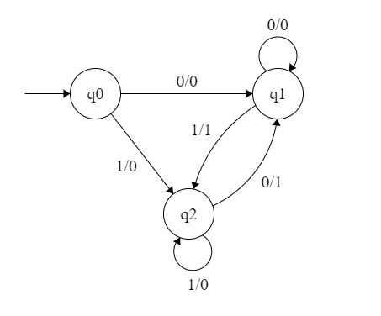
Mealy Machine M
Input: 11
Transitions: (q0,11)= (q2,1)=q2
output: 00

Slide 8
Conversion of Mealy to Moore Machine
 | Input=0 |  | Input=1
Present State | Next State | Output | Next State | Output
q0 | q1 | 0 | q2 | 0
q1 | q1 | 0 | q2 | 1
q2 | q1 | 1 | q2 | 0
Costas Busch - LSU

Slide 9
Conversion of Mealy to Moore Machine
Step 1. First find out those states which have more than 1 outputs associated with them.
q1 and q2 are the states which have both output 0 and 1 associated with them.
Step 2. Create two states for these states.
For q1, two states will be q10 (state with output 0) and
q11 (state with output 1). Similarly for q2, two states will be q20 and q21.
Step 3. Create an empty moore machine with new generated state.
For moore machine, Output will be associated to each state irrespective of inputs.
 | Input=0 | Input=1
Present State | Next State | Next State | Output
q0
q10
q11
q20
q21

Slide 10
Conversion of Mealy to Moore Machine
Step 4. Fill the entries of next state using mealy machine transition table shown in Table 1.
For q0 on input 0, next state is q10 (q1 with output 0).
Similarly, for q0 on input 1, next state is q20 (q2 with output 0).
For q1 (both q10 and q11) on input 0, next state is q10.
Similarly, for q1(both q10 and q11), next state is q21.
For q10, output will be 0 and for q11, output will be 1. Similarly, other entries can be filled.
 | Input=0 | Input=1
Present State | Next State | Next State | Output
q0 | q10 | q20 | 0
q10 | q10 | q21 | 0
q11 | q10 | q21 | 1
q20 | q11 | q20 | 0
q21 | q11 | q20 | 1

Slide 11
Conversion of Moore to Mealy Machine
Step 1. Construct an empty mealy machine using all states of moore machine as
shown in Table 4.
 | Input=0 |  | Input=1
Present State | Next State | Output | Next State | Output
q0
q10
q11
q20
q21

Slide 12
Conversion of Moore to Mealy Machine
Step 2: Next state for each state can also be directly found from
moore machine transition Table as:
 | Input=0 |  | Input=1
Present State | Next State | Output | Next State | Output
q0 | q10 |  | q20
q10 | q10 |  | q21
q11 | q10 |  | q21
q20 | q11 |  | q20
q21 | q11 |  | q20

Slide 13
Conversion of Moore to Mealy Machine
Step 3: As we can see output corresponding to each input in
moore machine transition table.
Use this to fill the Output entries. e.g.;
Output corresponding to q10, q11, q20 and q21 are 0, 1, 0 and 1 respectively.
 | Input=0 |  | Input=1
Present State | Next State | Output | Next State | Output
q0 | q10 | 0 | q20 | 0
q10 | q10 | 0 | q21 | 1
q11 | q10 | 0 | q21 | 1
q20 | q11 | 1 | q20 | 0
q21 | q11 | 1 | q20 | 0

Slide 14
Conversion of Moore to Mealy Machine
Step 3: As we can see output corresponding to each input in
moore machine transition table.
Use this to fill the Output entries. e.g.;
Output corresponding to q10, q11, q20 and q21 are 0, 1, 0 and 1 respectively.
 | Input=0 |  | Input=1
Present State | Next State | Output | Next State | Output
q0 | q10 | 0 | q20 | 0
q10 | q10 | 0 | q21 | 1
q11 | q10 | 0 | q21 | 1
q20 | q11 | 1 | q20 | 0
q21 | q11 | 1 | q20 | 0

Slide 15
Conversion of Moore to Mealy Machine
Step 4: As we can see from table 6, q10 and q11 are similar to each other
(same value of next state and Output for different Input).
Similarly, q20 and q21 are also similar. So, q11 and q21 can be eliminated.
 | Input=0 |  | Input=1
Present State | Next State | Output | Next State | Output
q0 | q10 | 0 | q20 | 0
q10 | q10 | 0 | q21 | 1
q20 | q11 | 1 | q20 | 0

